Slide 1



CSS Styling Introduction
About the Course
Doncho Minkov
Technical Trainer
http://minkov.it
Telerik Software Academy
academy.telerik.com

Slide 2


Table of Contents
Course Objectives & Course Program
Examination
Learning Resources

Slide 3


CSS Styling: Objectives & Program
What Topics Shall We Cover?

Slide 4


CSS Styling – Course Topics
CSS Overview
CSS Presentation
CSS Display
CSS Layout
Preprocessors and SASS
LESS
Test Preparation
CSS Test

Slide 5
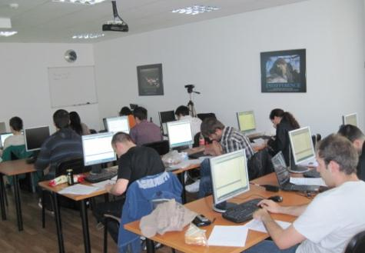


CSS Exam
Test & Examination Criteria

Slide 6
Scoring System for CSS Styling
Attendance – 10%
Test – 65%
Homework – 25%
Forums activity – bonus up to 10%
PC Magazine & Telerik Contest – bonus up to 10%
Helping the other students – bonus up to 10%
Knowledge sharing / blogging – bonus up to 20%

Slide 7
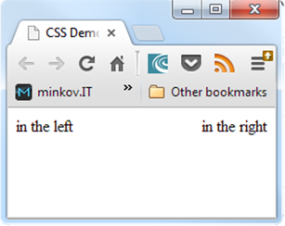
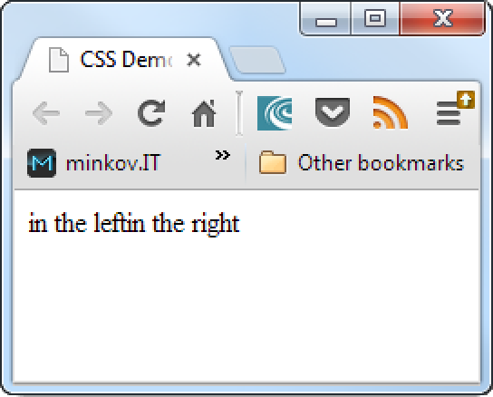
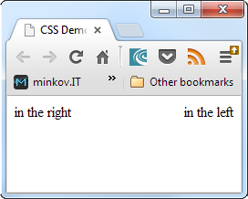
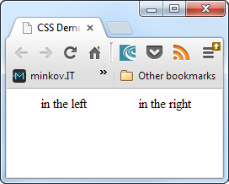
CSS Test – Sample Question
You are given the following HTML & CSS code:
What will be the output?
<body>
<div id="left-div">
in the left
</div>
<div id="right-div">
in the right
</div>
</body>
#left-div, #right-div {
text-align: center;
}
#left-div{
float:left;
}
#right-div{
float:right;
}

Slide 8
Pass / Fail / Excellence Criteria
CSS Test – pass / fail / excellence criteria:
Test
Very low results → fail (course not taken)
Average results → pass (course taken)
High results → pass with excellence

Slide 9
Homework Assignments
Doing your homework is very important!
Programming can only be learned through a lot of practice!
After each lecture there are a few exercises
Try to solve them in class
The rest are your homework
Homework assignments are due in 1-2 weeks after each lecture
Submissions will be accepted through the student's system: telerikacademy.com

Slide 10








Resources
What We Need in Addition to this Course Content?

Slide 11
Course Web Site & Forums
Register for the "Telerik Academy Forums":
Discuss the course exercises with your colleagues
Find solutions for the exercises
Share source code / discuss ideas
The CSS Styling official web site:
http://forums.academy.telerik.com/web-design-with-html5-css-and-javascript
http://academy.telerik.com/student-courses/web-design-and-ui/css-styling

Slide 12
Required Software
A text editor, one of the following:
Microsoft Visual Studio 2012 or Visual Studio Express 2012 (free version of VS 2012)
Notepad++
Komodo IDE
Sublime Text
Adobe Dreamweaver
MS WebMatrix

Slide 13
CSS Styling
http://academy.telerik.com

